Slide 1
International Osteoporosis Foundation and European Calcified Tissue Society Working Group
Recommendations for the screening of adherence to oral bisphosphonates
www.iofbonehealth.org

Slide 2
IOF-ECTS Working Group
Richard Eastell & Adolfo Diez-Perez (co-chairs)
KE Naylor, B Abrahamsen, D Agnusdei, ML Brandi, C Cooper, E Dennison, EF Eriksen, DT Gold, N Guañabens, P Hadji, M Hiligsmann, R Horne, R Josse, JA Kanis, B Obermayer-Pietsch, D Prieto-Alhambra, JY Reginster, R Rizzoli, S Silverman, MC Zillikens

Slide 3
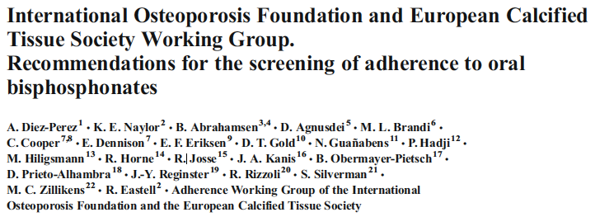
Osteoporos Int (2017) 28:767–774

Slide 4
BACKGROUND I
Bisphosphonates (BPs) are considered a first-line treatment of osteoporosis
Adherence to BPs has been reported at 50% or below after one year¹⁻³
Low adherence results in lack of efficacy (no or limited decrease in fracture risk) and reduced cost effectiveness⁴
1. Cramer JA, et al (2007). Osteoporos Int 18(8):1023–1031; 2. Kothawala P, et al (2007). Mayo Clin Proc 82(12):1493–1501; 3. Kanis JA, et al (2012). Osteoporos Int 23(1):213–221; 4. Hiligsmann M et al (2010). Calcif Tissue Int 86(3):202–210

Slide 5
BACKGROUND II
Bone turnover markers (BTM) reflect the tissue effect of BPs¹
Measurement of BTM has been proposed for monitoring treatment²
Serum CTX and PINP have been recommended as reference markers of bone turnover¹
1. Vasikaran S et al (2011). Osteoporos Int 22(2): 391–420; 2. Kanis JA et al (2013) Osteoporos Int 24(1):23–57

Slide 6
Working Group on Adherence of the IOF and the ECTS
Question to be addressed:
Can the bone turnover markers PINP and CTX be used to identify low adherence in patients with postmenopausal osteoporosis initiating oral bisphosphonates for osteoporosis?

Slide 7
METHODS: THE TRIO STUDY (I)
The TRIO Study¹ was specifically addressing the question raised by the Working Group
RCT of 172 postmenopausal women with osteoporosis
Effect of Aln, Ris and Ibn on BTM
Proportion of cases with decreases in BTM beyond the LSC (2-tailed) at three months
1. Naylor KE et al (2016) . Osteoporos Int 27(1):21–31

Slide 8
METHODS: THE TRIO STUDY (II)
Blood sampling at baseline and several times after starting BPs
Adherence evaluated by the Medication Event Monitoring System (MEMS) caps
Represent a benchmark for measuring the effect of treatment on BTM
1. Naylor KE et al (2016) . Osteoporos Int 27(1):21–31

Slide 9
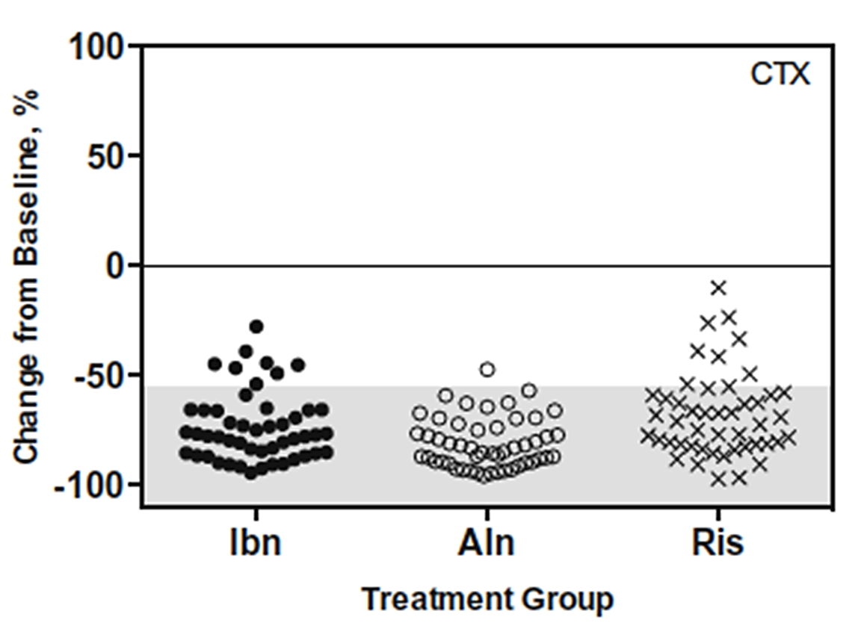
Effect of BPs on serum CTX
LSC threshold

Slide 10
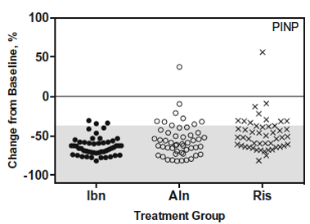
Effect of BPs on serum CTX
LSC threshold

Slide 11
Performance of BTMs for screening
Detection rate: proportion of patients with changes in BTMs that exceed the least significant change when taking oral BPs.
A (positive)
Detection rate =
A (positive) + C (negative)
Positive = Cases with a decrease > LSC in one or both BTM
Negatives = Cases with decrease < LSC or no decrease
LSC = Least significant change

Slide 12
DETECTION RATE
BTM (IDS iSYS) | N | Decrease >LSC (N) | Decrease < LSC (N) | Detection Rate(%)
CTX | 146 | 127 | 19 | 86.9
PINP | 149 | 125 | 24 | 83.9
CTX + PINP | 146 | 138 | 8 | 94.5

Slide 13
CRITICAL VALUES FOR PINP AND CTX
 | PINP |  | CTX
 | IDS iSYS | Roche Cobas e411 | IDS iSYS | Roche Cobas e411
Controls, mean | 31 μg / L | 33 μg / L | 327 ng / L | 221 ng / L
LSC | 29% | 23% | 54% | 50%
LSC | 6.2 μg / L | 5.7 μg / L | 80 ng / L | 60 ng / L
Effect | -51 % | -54 % | -75 % | -74 %
Effect | -28 μg / L | -32 μg / L | -490 ng / L | - 360 ng / L
Reproduced from Eastell R et al., Diagnosis of endocrine disease: Bone turnover markers: are they clinically useful? Eur J Endocrinol. 2018 178:R19-R31 with permissions from BioScientifica Ltd.

Slide 14
ALGORITHM FOR ADHERENCE SCREENING
BTM
Decrease
> LSC
Continue
Treatment
Baseline
BTM
(PINP, CTX)
3-months
BTM
(PINP, CTX)
BTM
Decrease
< LSC
Reassess
Treatment
Treatment
initiation

Slide 15
IF BTM DO NOT DECREASE…
Poor adherence !!!
Treatment stopped
Wrong administration
Reassess treatment
Other causes
Undetected secondary osteoporosis
Interfering medications
Lack of efficacy

Slide 16
CONCLUSION
Bone turnover markers are efficient for the screening of adherence to oral bisphosphonates
Two measurements, at the treatment initiation and at month three, are recommended

Slide 17
Acknowledgment
The educational slide kit was made possible through an unrestricted grant from

