Slide 1
Presentation of the Capture the Fracture® Partnership initiative

Slide 2
Capture The Fracture® Program
A global flagship programme by the International Osteoporosis Foundation (IOF)
Launched in 2012
Mission: Facilitating the implementation of Post-Fracture Care Coordination programs/ Fracture Liaison Services (FLS) for secondary fracture prevention

Slide 3
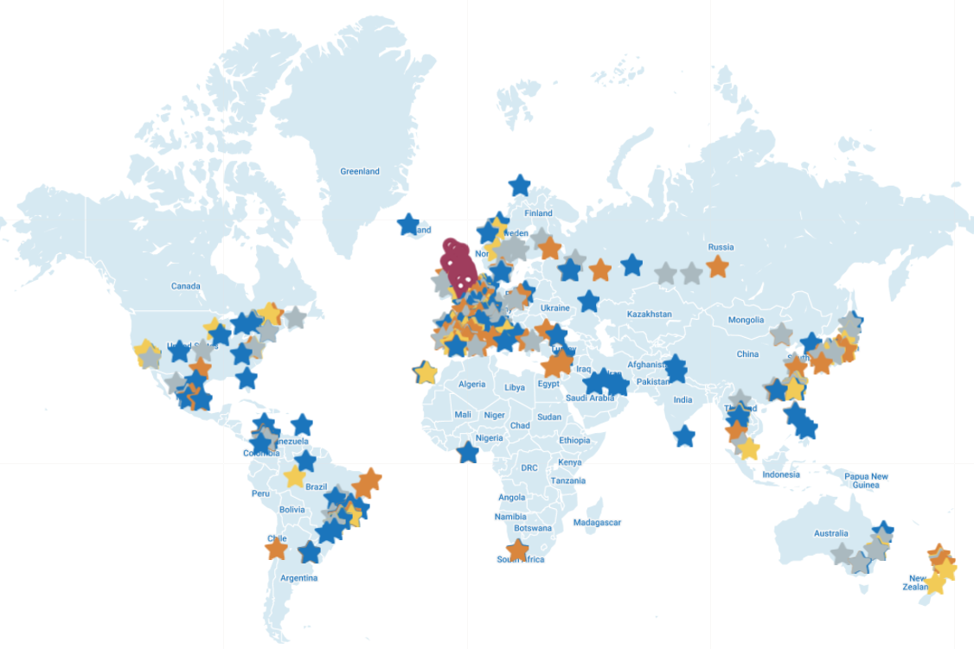
International Map of Best Practice
International recognition for Post- Fracture Care Coordination Programs/ Fracture Liaison Services worldwide
636 FLS Mapped from 48 countries
https://www.capturethefracture.org/map-of-best-practice

Slide 4
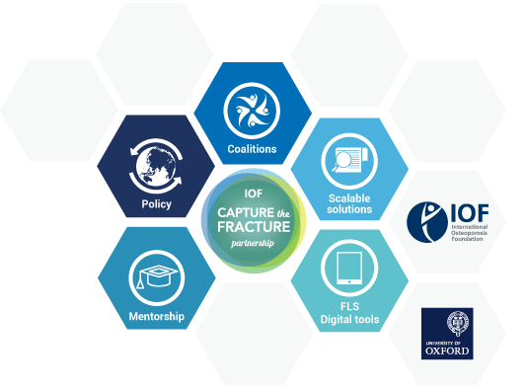
Capture the Fracture® Partnership

Slide 5
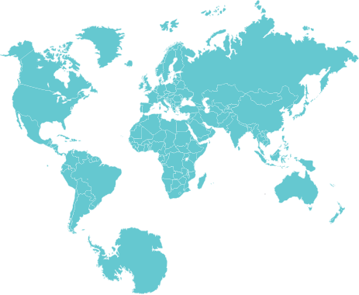
Capture the Fracture® Partnership
Objectives
Objectives
Foster the development and implementation of new Capture the Fracture® initiatives
Double number existing of FLS who are part of the CTF network by 2022
Increase quality of the 390 FLS part of the CTF network
Regions: Asia Pacific, Latin America, Middle East and North Africa, Europe
Countries: Argentina, Australia, Brazil, China, Colombia, France, Germany, Italy, Japan, Korea, Mexico, Netherlands, Russia, Saudi Arabia, Spain, Sweden, Taiwan, Turkey

Slide 6
Capture the Fracture® Partnership
5 Pillars
POLICY
Bringing policy makers, regulators, professional and patient, organizations and opinion leaders together around a defined call to action to drive policy change to enable specific, impactful changes at the local, regional and national level.
MENTORSHIP
Providing customized educational, best practices and peer-to-peer mentorship support and tools (both to established PFC programs and those under development) to ensure long-term sustainability.
SCALABLE SOLUTIONS
Creating a central, go-to hub of resources, solutions and best practices to enable PFC programs to more efficiently start and improve the delivery of PFC services.
DIGITAL TOOL
Capturing critical globally-recognized PFC key performance indicators in a digital tool to help PFC programs improve the effectiveness of their program and increase patient outcomes.
COALITION
Uniting national societies with medical groups, Non-Government Organizations (including patient societies) and other stakeholders to amplify the four additional program pillars at a national, regional and international level.

Slide 7
Policy Pillar

Slide 8
Policy Pillar
Aim
Outreach to key stakeholders to drive fracture prevention policy change that will prioritize bone health and post-fracture care through the implementation of Post-Fracture Care (PFC) coordination programs such as Fracture Liaison Service (FLS)

Slide 9
Policy Pillar
Outcomes
National policy changes to increase in the standards of quality of care for patients
National funding and coverage
Understand patient pathway
Increase quality of existing PFC programs/FLS
Increase number of new PFC programs/FLS
Increase engagement with policymakers

Slide 10
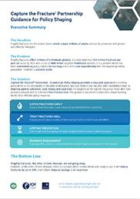
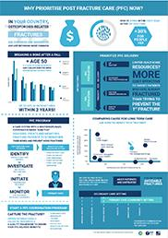
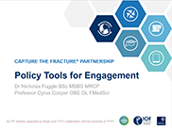
Policy Resources
Capture the Fracture® Partnership – Guidance for Policy Shaping - comprehensive document that makes the case for fracture prevention – in English & Spanish
Executive 1-page summary of the Capture the Fracture Partnership – Guidance for Policy Shaping - in Arabic, Dutch, French, Italian, Japanese, Korean, Spanish, Portuguese, Russian, Turkish
Slide kit summarising key messages & findings of the Capture the Fracture® Partnership – Guidance for Policy Shaping - in Arabic, Dutch, French, Italian, Japanese, Korean, Spanish, Portuguese, Russian, Turkish
Infographic illustrating need for Post-Fracture Care – in English & Spanish
Country specific policy landscape

Slide 11
CAPTURE THE FRACTURE® PARTNERSHIP
Country specific policy landscape assessment
Fractures abound
Current gaps in provision
Solutions exist
A problem on the rise
Impact increasing
Build your response
Expected benefits

Slide 12
Benefit Calculator
Objectives
Online tool for multiple stakeholders
Costs associated with FLS
Outcomes associated with FLS
To produce national and local estimates of introducing FLS

Slide 13
Mentorship Pillar

Slide 14
Mentorship Pillar
Aim
To expand on the success of the original mentorship model by establishing a community of national mentors with knowledge, skills and competencies to support Post-Fracture Care Coordination Programs/Fracture Liaison Service (FLS) establishment, sustainable development and good patient experience

Slide 15
Mentorship Pillar
Key activities
Mentorship
CTF educational program of webinars & Best Practice Framework material
Peer to peer mentorship & e-learning linked to evidenced methods of quality improvement
CTF Getting to Gold program (4 steps: Train the local mentor, getting started and sustainable, getting funded, drive policy changes tours)

Slide 16
Getting to Gold Programme
TRAIN THE MENTOR
GETTING STARTED & SUSTAINABLE
POLICY MAKERS FORUM*
RAISE VISIBILITY*
GETTING FUNDED
Training a Community of Mentors
Deliver a framework to support PFC/FLS development from policy development to FLS sustainability
The program is comprised of three (3) steps focused on building key capabilities:
PFC/FLS management
Quality Improvement
Mentorship

Slide 17
Scalable Solutions Pillar

Slide 18
Scalable Solutions Pillar
Aim
Establish scalable solutions to support FLSs with quality improvement and scalability. Provide through the Capture the Fracture® platform, a global online resource centre with numerous educational tools that will support and facilitate the rapid and effective Implementation of FLS.

Slide 19
Resource Centre
Global online hub of resources comprised of numerous educational tools for PFC programs/FLS implementation & sustainability
Slide Kits
Templates
Documents
Videos
Reports

Slide 20
CTF Resource Center
PFC/ FLS Implementation
PFC/FLS Quality Improvement
PFC/FLS Sustainability
Advocacy for PFC /FLS
https://www.capturethefracture.org/resource-center

Slide 21
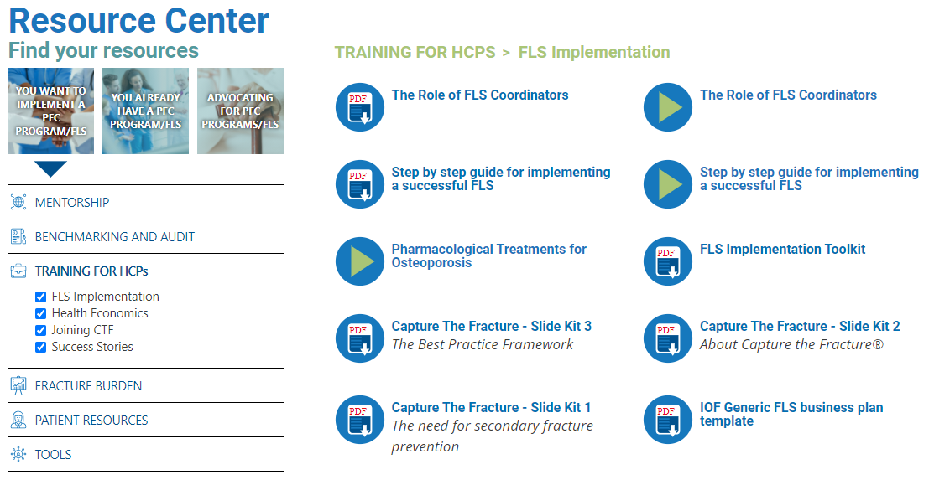
CTF Resource Center
Implementation section – Training for HCPs
Navigation panel
View full list

Slide 22
Digital Tool Pillar

Slide 23
Digital Tool Pillar
Aim
To create a global FLS Digital tool to document and track patient and institutional Key Performance Indicators (KPIs), include fracture identification, investigation, screening, and treatment initiation/adherence.

Slide 24
Digital Tool
A user-friendly software aiming to
Provide continuity of care
Manage patients more effectively
Improve clinical outcomes
Reduce medical & healthcare costs

Slide 25
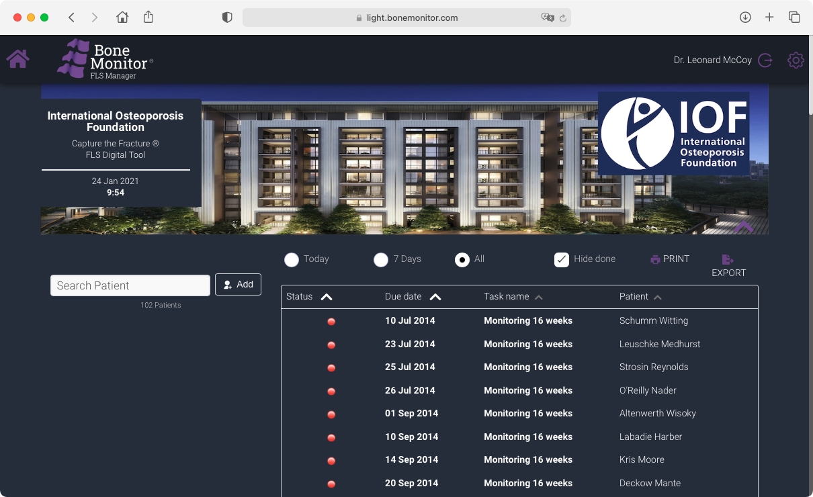
Digital Tool
Functions and specifications
A web-based service in the FLS center, to support the FLS team to more effectively track and monitor patients
KPIs dashboard to measure and optimize the associated processes
Optimized Workflow to reduce administrative overhead and double work
Reduction of costs for human ressources

Slide 26
Coalition Pillar

Slide 27
Coalition Pillar
Aim
Establish and leverage existing regional and local coalitions with Key Opinion Leaders (KOLs) and national societies and to ultimately create global bone health coalitions to drive secondary fracture prevention

Slide 28
Coalition Pillar
Pivot role
Driving Policy Changes
Educational support & tools
FLS / patient
Resources
Patient pathway
Benchmarking
& effectivenes

Slide 29
Coalition Pillar
Objectives
Coalitions
Promote education of HCPs
Develop and improve of Post Fracture Care Coordination Programs
Support & advocate for Policy changes
Support communication at national level
Foster liaison with policy makers & government officials
Education of HCPs

Slide 30
Coalition Pillar
Outcomes
National policy changes
National insurance coverage changes
Implementation of FLS
Increase the quality of existing FLS
Improve the patient pathway
Raise visibility of IOF and CTF programme

Slide 31
Coalition Pillar
Key Opinion Leaders
Engagement
Support for local strategy
Support for local operations
Expertise
PFC programs/FLS
Clinical/Research
Specialties
Rheumatologist
Orthopedic surgeon
Epidemiologist
Nurse
Endocrinologist
Geriatricians
Orthogeriatric
Physiotherapist
Training/Education
Policy & decision makers
Media relations
Insurance
Digital Tools
Patient /Advocacy
Primary Care Physician
Pharmacist
Etc

Slide 32
Coalition Pillar
Stakeholders
Stakeholders
Not-for-Profit organizations (NGOs)
Institutions ​
National governments​
National and private health insurances

Slide 33
National Council for secondary fracture prevention
Role
National Council for secondary fracture prevention
Drive local policy changes
Drive insurance policy change (insurance coverage)
Implement Fracture Liaison Services (FLS)
Increase the quantity and quality of existing FLS
Support FLS sustainability
Raise IOF & CTFP/CTF visibility

Slide 34
National Council for secondary fracture prevention
Countries with existing coalitions
National network & pool of experts (KOLs)
Shared mission
Strategy
Outcomes
Support & Resources
Policy, Education and Advocacy
Policy Prioritisation to
fund PFC/ FLS
Existing activities
Recognition

Slide 35
National Council for secondary fracture prevention
Countries with need to establish coalition
Identification of key stakeholders
Engagement of key stakeholders
Assessment of opportunities & needs
Alignment on strategy & ouctomes
Effective planning
Monitoring and support

Slide 36
Capture the Fracture® Partnership
Key contacts
Philippe Halbout – Chief Executive Officer
philippe.halbout@osteoporosis.foundation
Anastasia Soulié– CNS & CTFP Project Leader
anastasia.soulie@osteoporosis.foundation

