Slide 1
GLOBAL DIETARY CALCIUM INTAKE AMONG ADULTS:
A SYSTEMATIC REVIEW

Slide 2
CALCIUM STEERING COMMITTEE
Chair: Bess Dawson-Hughes
Members: Patricia Clark, Peter Ebeling, Ambrish Mithal, René Rizzoli, Cristiano Zerbini, Cyrus Cooper (ex-officio)
In collaboration with Ethan Balk, Associate Director, Brown Evidence-based Practice Center Brown University, USA

Slide 3
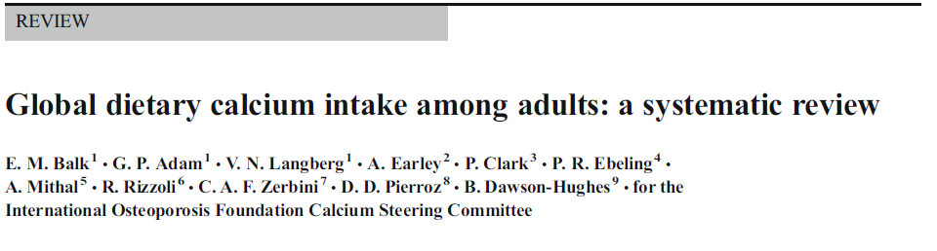
Osteoporos Int. 2017 Dec;28(12):3315-3324. doi:10.1007/s00198-017-4230-x.

Slide 4
BACKGROUND: CALCIUM
An important component of bone
30-35% of bone mass and much of its strength
Seniors¹: Loss of approx. 15 g per year
Low calcium intake may adversely affect the development of peak bone mass in adolescents
¹Heaney et al (1982) J Lab Clin Med 99:46-55

Slide 5
OBJECTIVES
To describe dietary calcium intake in the general population in different countries.
To find the most representative data for each country.
To recognize that the presence of low calcium intake is the first step in developing culturally appropriate strategies and policies to optimize intake.

Slide 6
SYSTEMATIC REVIEW
Literature search
  Databases: Pubmed, Embase, CAB abstracts, CINAHL, Global Health and 8 databases for studies reporting national average dietary Ca intake in adults
  Criteria of inclusion:
    Healthy men and women (>18 years)
    Publication since 2000
    Priority to large national surveys, but inclusion of convenience samples or smaller or older studies if necessary
    Exclusion of children, institutionalized or hospitalized adults, pregnant or lactating women

Slide 7
SEARCH RESULTS
9,780 abstracts screened
478 articles retrieved
Data from 74 countries identified – 123 countries without qualifying data

Slide 8
FLOW CHART
Citations retrieved from 13 databases (see text) and internet searches
(N=9780)
Excluded in abstract screening
(N=9337)
Full text articles retrieved
(N=443)
Excluded (N=367)
No calcium data (N=122)
Less restrictive available (N=103)
More recent available (N=65)
Calcium data not mg/day or equivalent (N=26)
Not available (N=16)
Duplicate data (N=14)
Better reporting elsewhere (N=8)
Crop/market food data (N=5)
Bone mineral density study (N=3)
Child study (N=2)
Calcium only from specific food source (N=2)
Case control study (N=1)
Study data made
available to us
via domain experts
(N=2)
Includes studies:
(78 studies* of 74 countries)

Slide 9
RESULTS I
Globally Ca intake ranged from 175 mg /d in Nepal to 1233 mg/d in Iceland.
Most countries in South, East, and Southeast Asia had an average Ca intake under 400 to 500 mg/d, including China, India, Indonesia, Vietnam.
Most countries in Africa with data and South America had an average Ca intake of 400 – 700 mg/d.

Slide 10
RESULTS II
Many countries in Africa, Central and South America, the Middle East, and Central Asia did not have available estimates.
All countries in Northern Europe had an average Ca intake >1000 mg/d.
No clear pattern based on sex, age, urban versus rural residence or income groups across countries.

Slide 11
LIMITATIONS
Only 18/74 countries had published current and nationally representative data.
Sample sizes ranged from 32 to 306,329 participants.
35% of the studies were conducted in specific towns, cities, or regions.

Slide 12
GLOBAL DIETARY CALCIUM INTAKE IN ADULTS
Osteoporos Int (2017) 28:3315-3324

Slide 13
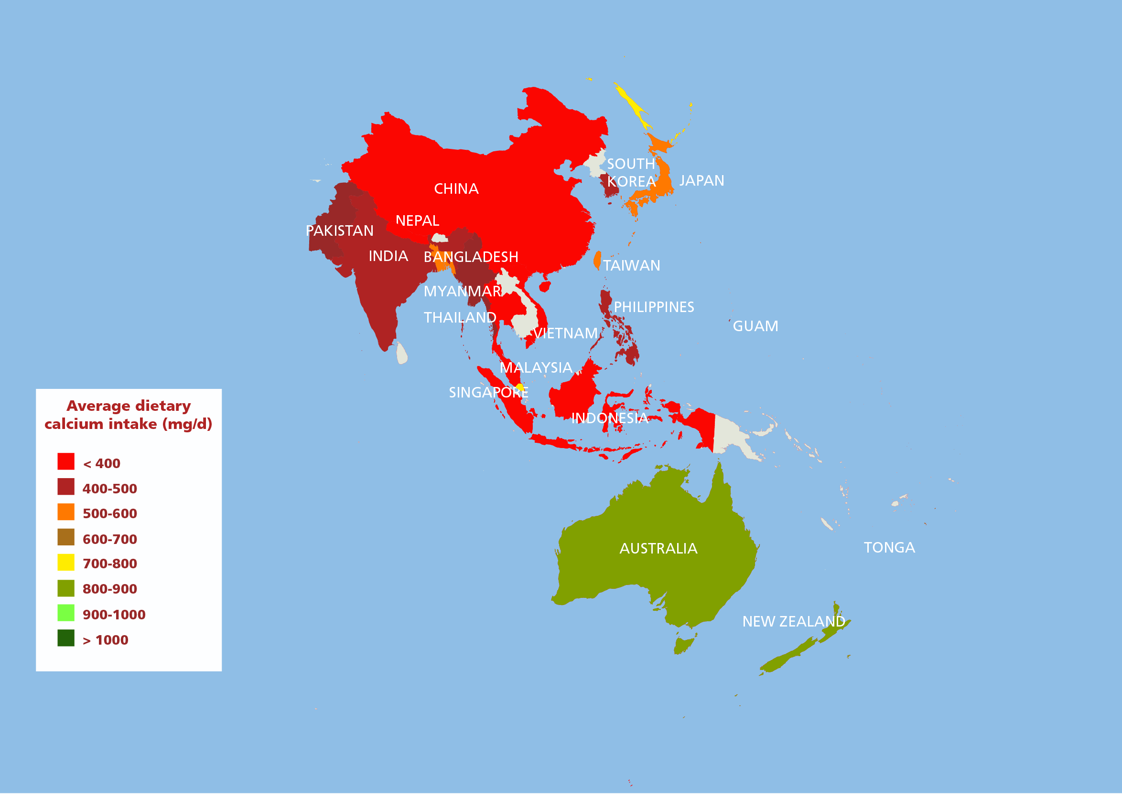
IN ASIA-PACIFIC REGION
Adapted from Osteoporos Int (2017) 28:3315-3324

Slide 14
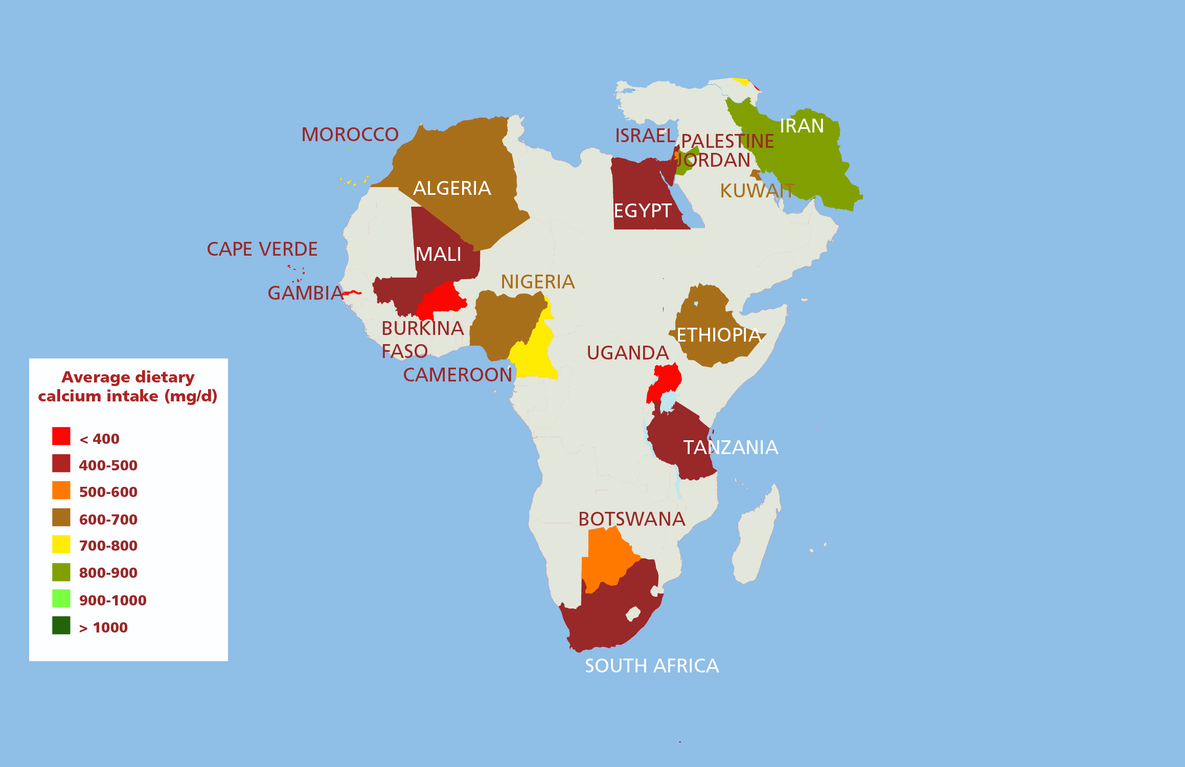
IN MIDDLE-EAST AND AFRICA
Adapted from Osteoporos Int (2017) 28:3315-3324

Slide 15
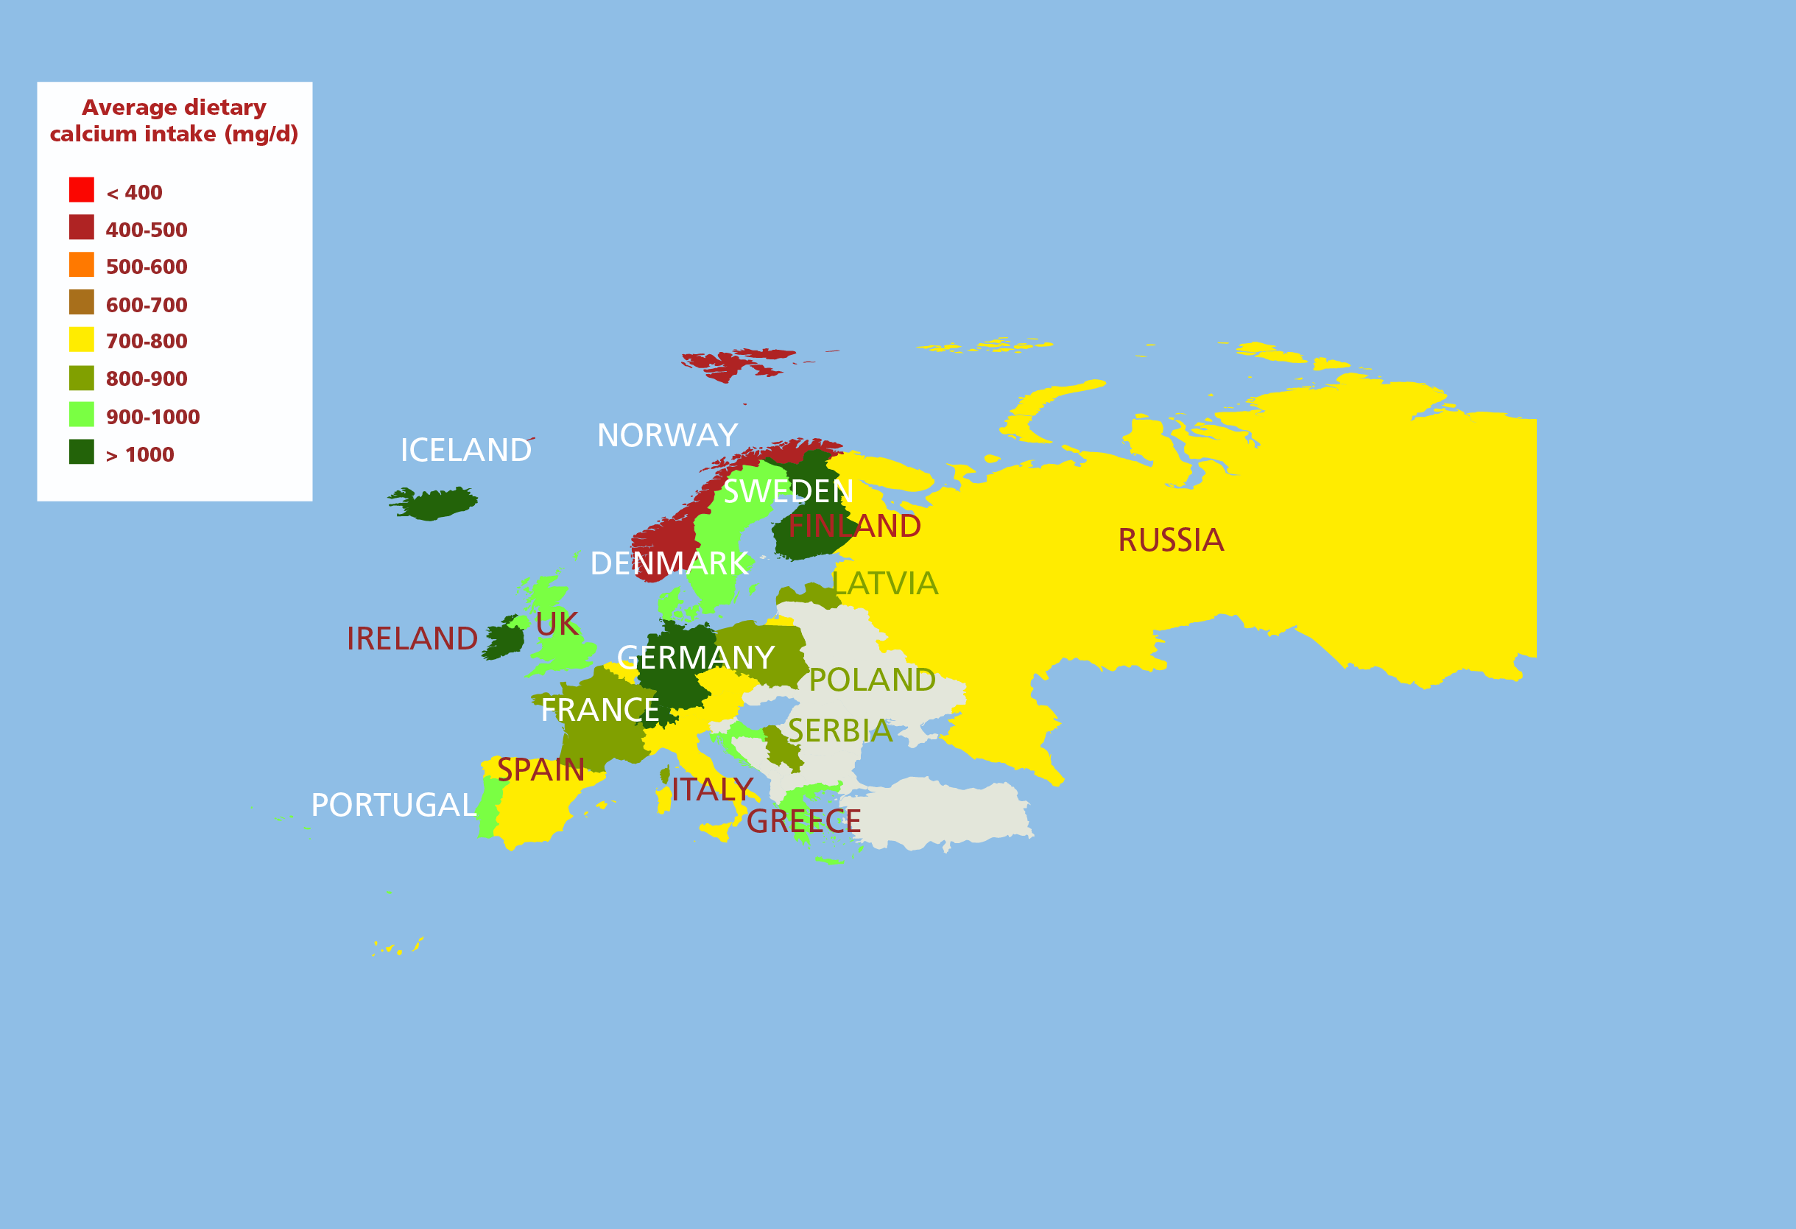
IN EUROPE
Adapted from Osteoporos Int (2017) 28:3315-3324

Slide 16
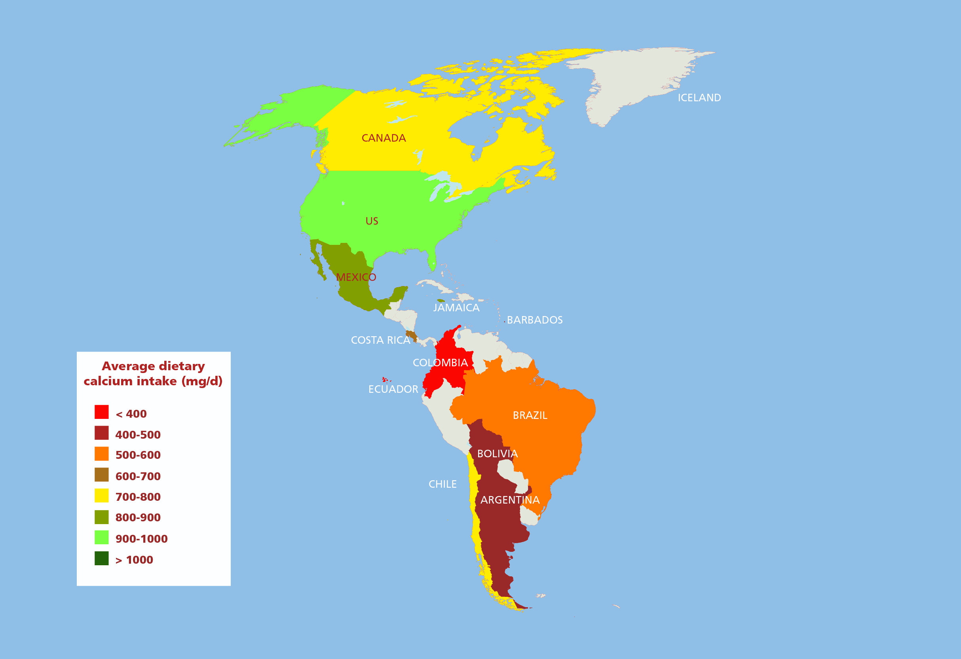
IN AMERICAS
Adapted from Osteoporos Int (2017) 28:3315-3324

Slide 17
CONCLUSIONS
Calcium intake is low in many large countries of Southeast Asia (averaging less than 400 mg/d)
And nearly as low in much of South America.
No published data on dietary calcium intake in over 60% of the world’s countries.
Measures to increase calcium intake are likely to have skeletal benefits.

Slide 18
“This study draws attention to regions where calcium intake needs to be assessed and where measures to increase calcium intake would likely provide skeletal benefits for the population. This is a necessary first step in developing culturally appropriate strategies and policies to address the deficiency.”
Bess Dawson-Hughes, chair of the steering committee

Slide 19
ACKNOWLEDGEMENTS
Supported by an unrestricted educational grant from
Pfizer Consumer Health

