Slide 1
IOF COMPENDIUM OF OSTEOPOROSIS
2nd EDITION - 2019
A review of key messages

Slide 2
WHAT IS OSTEOPOROSIS?
It is a condition where bones become porous and lose their strength.
Osteoporosis is also known as the ‘silent disease’ because bone loss occurs without symptoms.
In fact, even after breaking a bone, around 80% of patients are still not diagnosed and treated for osteoporosis
Harvey NCW, McCloskey EV et al. 2016 IOF World Osteoporosis Day Report

Slide 3
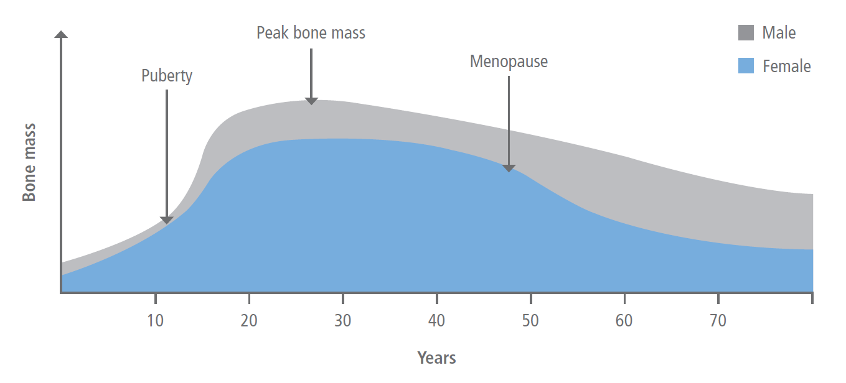
WHO IS AFFECTED?
Worldwide, osteoporosis-related fractures affect:
Women: 1 in 3 aged 50+
Men: 1 in 5 aged 50+
Hip, spine and wrist fractures are the most common
Women most at risk due to accelerated period of bone loss following menopause
Fortunately, the right lifestyle and medical treatment makes a huge difference
Cooper C et al. Healthy nutrition, healthy bones: How nutritional factors affect musculoskeletal health throughout life

Slide 4
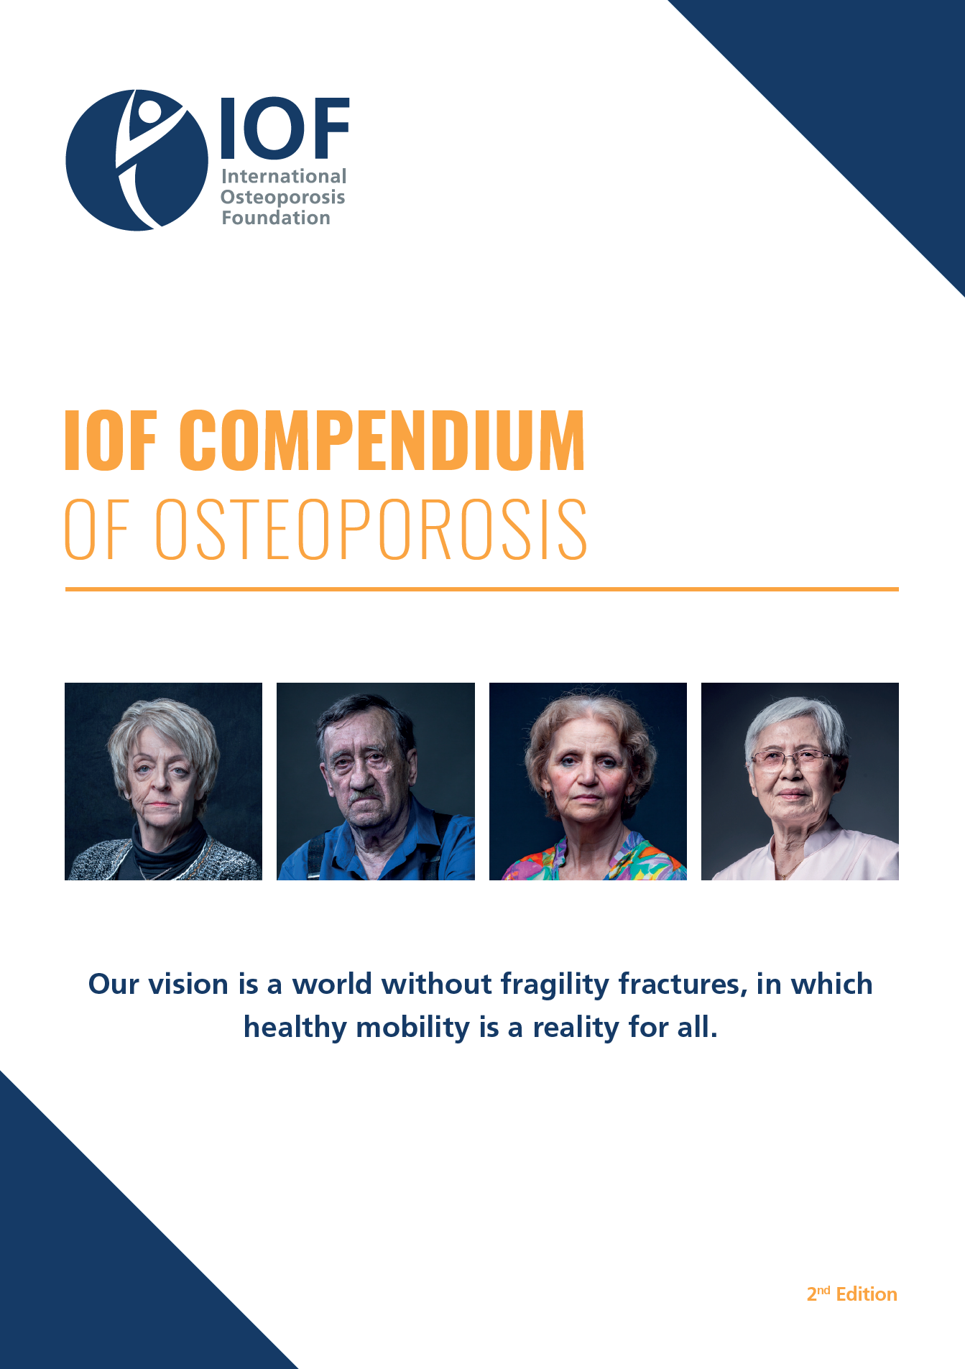
ABOUT THE IOF COMPENDIUM
The IOF Compendium of Osteoporosis serves as a reference point for all key stakeholders in the field of musculoskeletal health globally.
A summary of the current knowledge of bone biology and risk factors.
Clear recommendations for achieving optimal bone health for all.
Available at:
https://www.iofbonehealth.org/compendium-of-osteoporosis
IOF Compendium of Osteoporosis 2019. 2nd Edition

Slide 5
THE GLOBAL POPULATION IS AGEING
Fracture incidence will increase dramatically in the coming decades

Slide 6
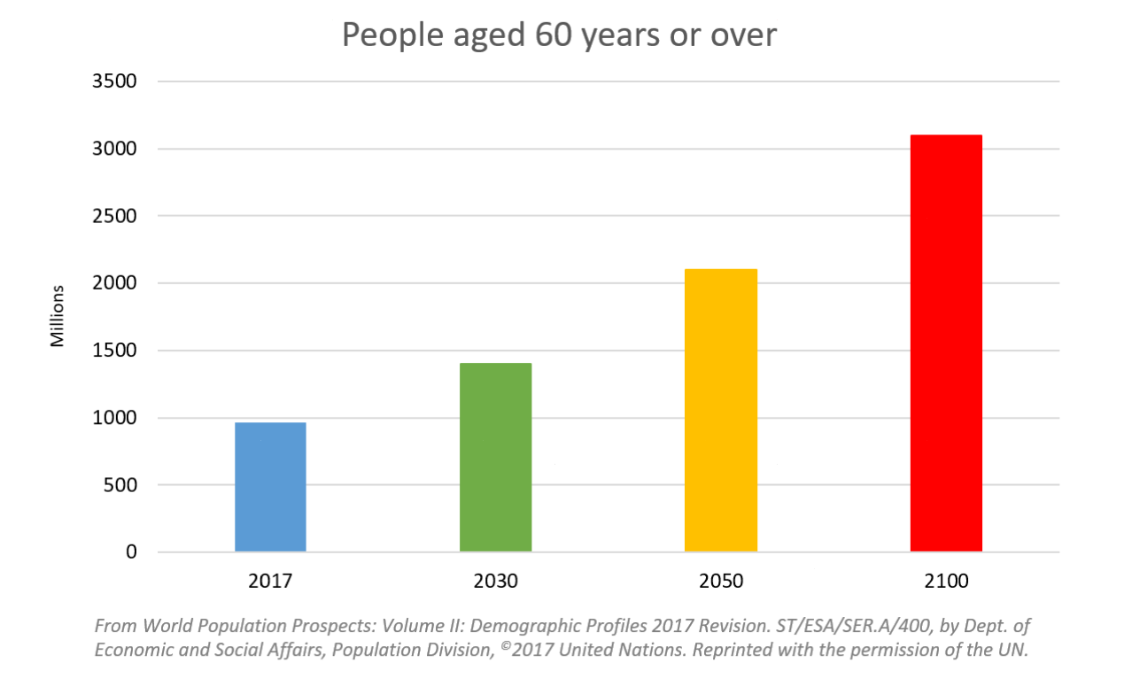
UNITED NATIONS POPULATION PROSPECTS
Global population aged 60 years or over 2017-2100

Slide 7
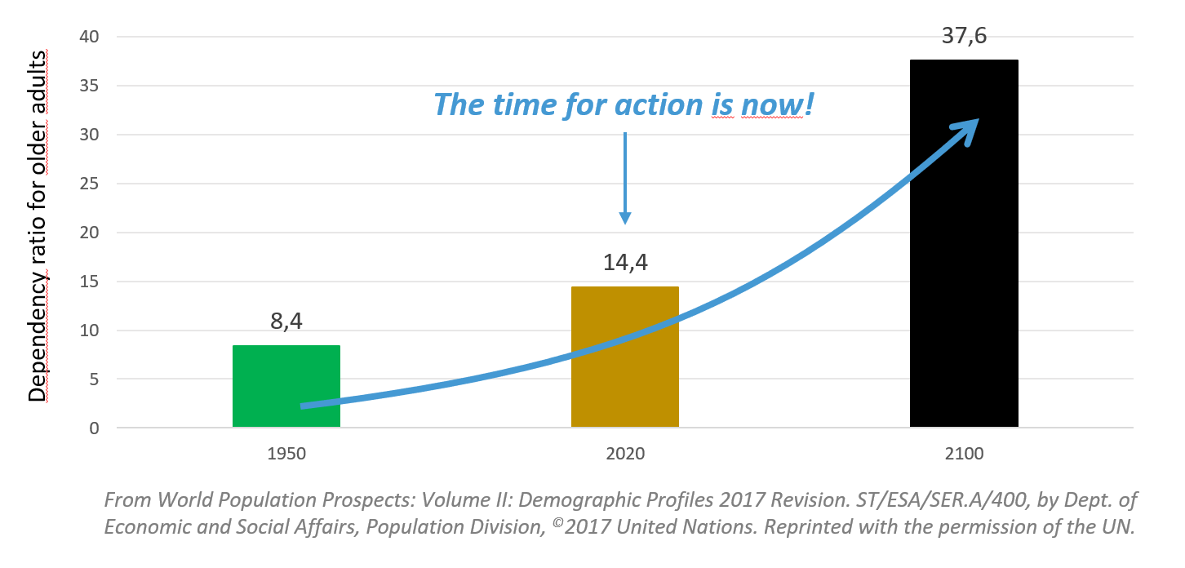
DEPENDENCY RATIO FOR OLDER ADULTS
World 1950-2100
Dependency ratio: number of dependents per 100 persons of working age
“The dependency ratios clearly show that maintaining mobility and independence in older populations is increasingly a matter of necessity.” Cyrus Cooper, IOF President

Slide 8
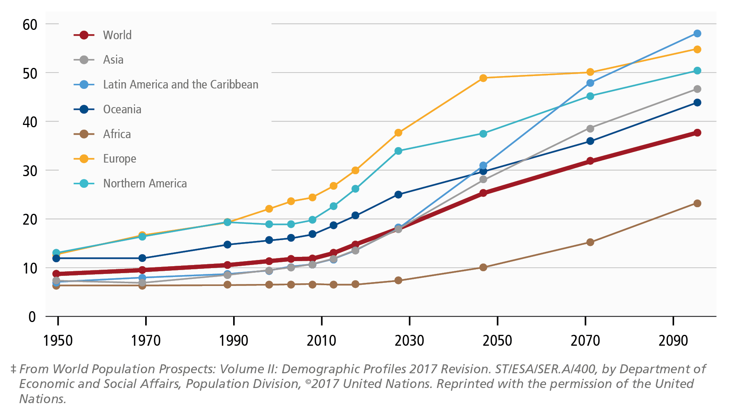
DEPENDENCY RATIO FOR OLDER ADULTS
World and World Regions 1950-2100
Dependency ratio of older adults
Dependency ratio: number of dependents per 100 people of working age
The ratio of the population aged 65 years or over to the population considered to be of working age (i.e. 15-64 years).

Slide 9
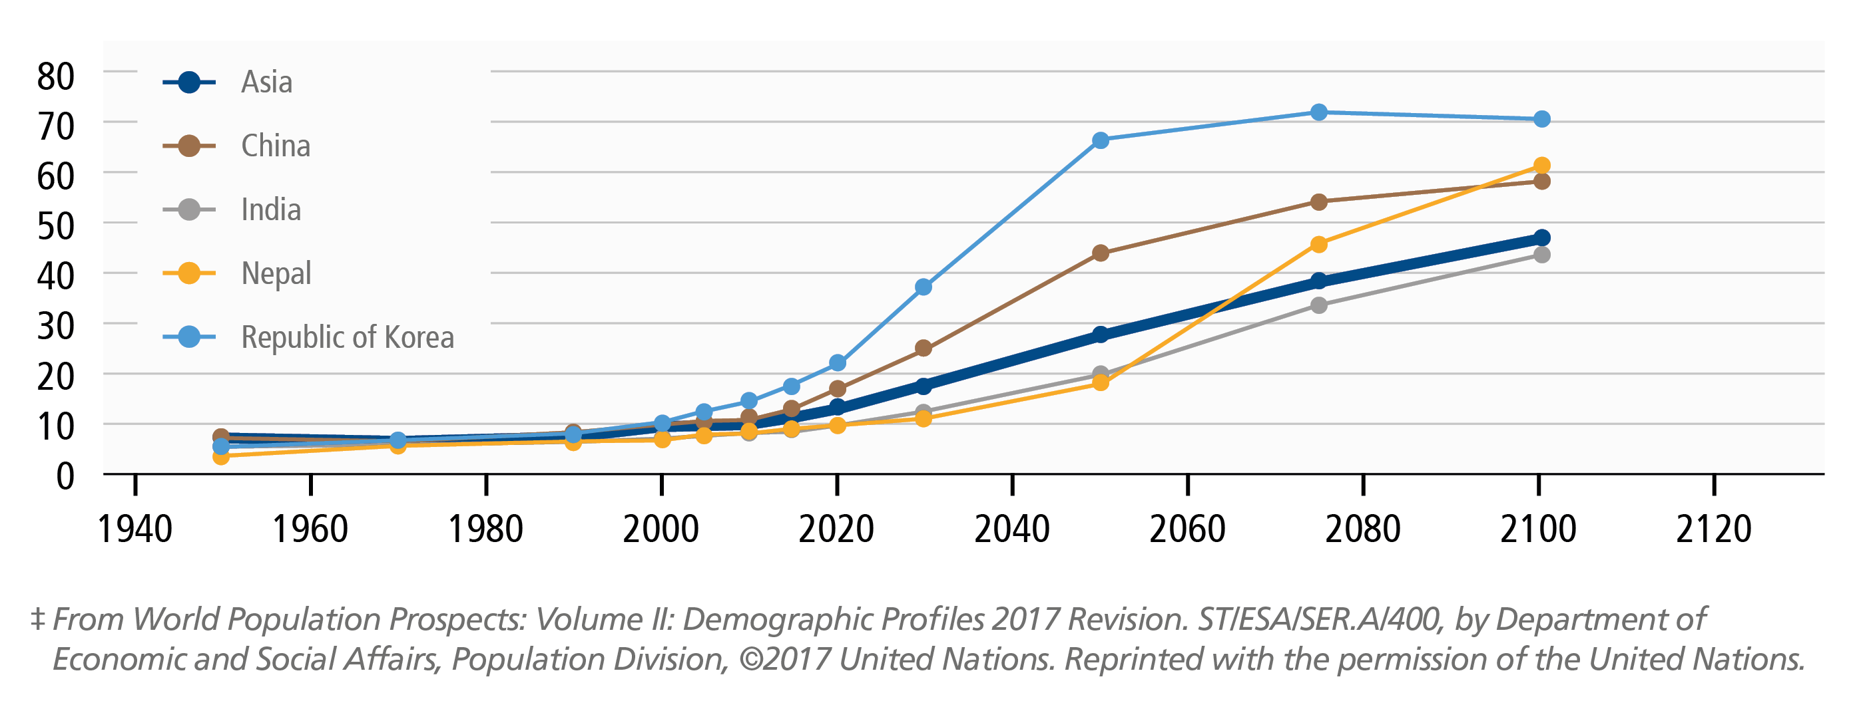
EPIDEMIOLOGY & BURDEN: ASIA-PACIFIC
Asia-Pacific: By 2050, about 1.3 billion people in Asia will be aged 60 and over, and 1/4 of a billion will be aged 80 years +
Half of all hip fractures will occur in Asia by 2050
In 2000 just 9.1 out of 100 people were aged 65 and over. This number is expected to triple by 2050 (27.8) and quintuple by 2100 (46.3).
Dependency ratio of older adults
Dependency ratio: number of dependents per 100 people of working age

Slide 10
EPIDEMIOLOGY & BURDEN: ASIA-PACIFIC
China: 411,000 cases of hip fracture in 2015
Approx. 1 million cases by 2050
Societal cost of US$11 billion in 2015
Approximate societal cost of US$25 billion in 2050
Japan: 176,000 hip fracture cases in 2012
Approximate societal cost of US$25 billion in 2050
Republic of Korea: most stark demographic shift this century.
Estimated at 66.3 seniors per 100 workers in 2050
Societal cost of US$149 million in 2011
Dependency ratio of older adults
Dependency ratio: number of dependents per 100 people of working age

Slide 11
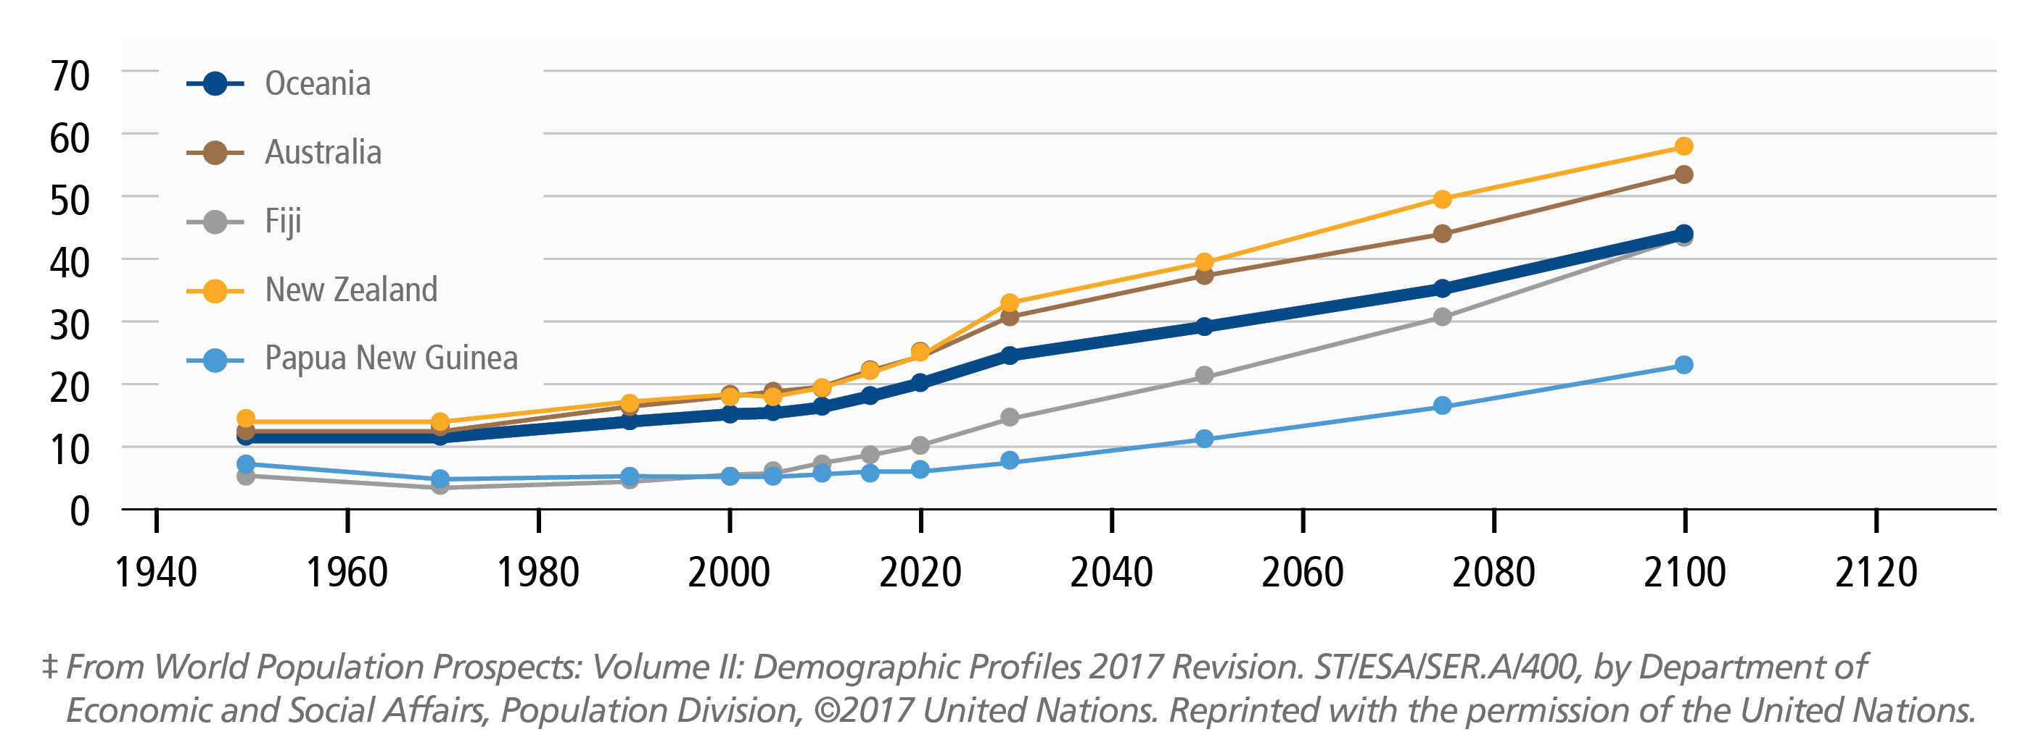
EPIDEMIOLOGY & BURDEN: ASIA-PACIFIC
Australia
Societal cost of AU$2.4 billion in 2019
Societal cost of AU$2.6 billion in 2022
Australia: The National Health and Medical Research Council recommends the intake of 1,000 mg per day of calcium.
Dependency ratio of older adults
Dependency ratio: number of dependents per 100 people of working age

Slide 12
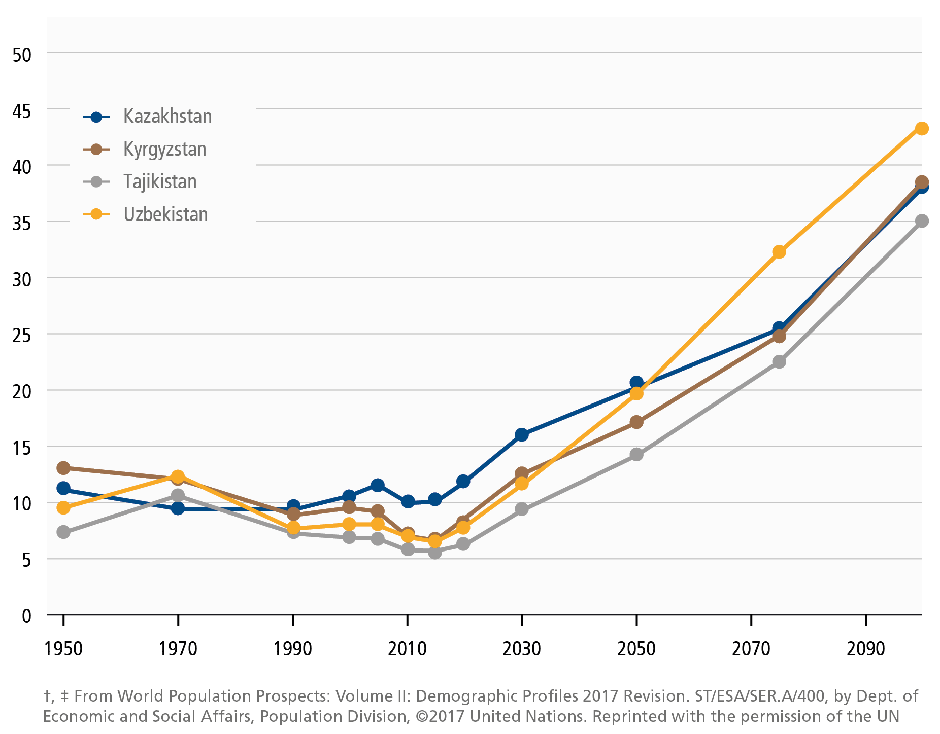
EPIDEMIOLOGY & BURDEN: CENTRAL ASIA
Central Asia: All four countries will experience major demographic shifts during the second half of the century.
Kyrgyzstan: Future estimates of 2,300 hip fracture cases per year
Uzbekistan: In 2016, 36% of women 50 and over had osteoporosis
Dependency ratio of older adults
Dependency ratio: number of dependents per 100 people of working age

Slide 13
EPIDEMIOLOGY & BURDEN: EUROPE
Europe: remains the world’s oldest region
In 2050, about 48.7 out of 100 people will be aged 65 and over
Europe: In 2010, 3.5 million fragility fractures
A societal cost of € 37 billion
approx. 98 billion when accounting for quality adjusted life year (QALY)
In 2017, 19% were aged 65 years and over
By 2050, about 28.1% of the EU-28 population will be aged 65 years and over
Dependency ratio of older adults
Dependency ratio: number of dependents per 100 people of working age

Slide 14
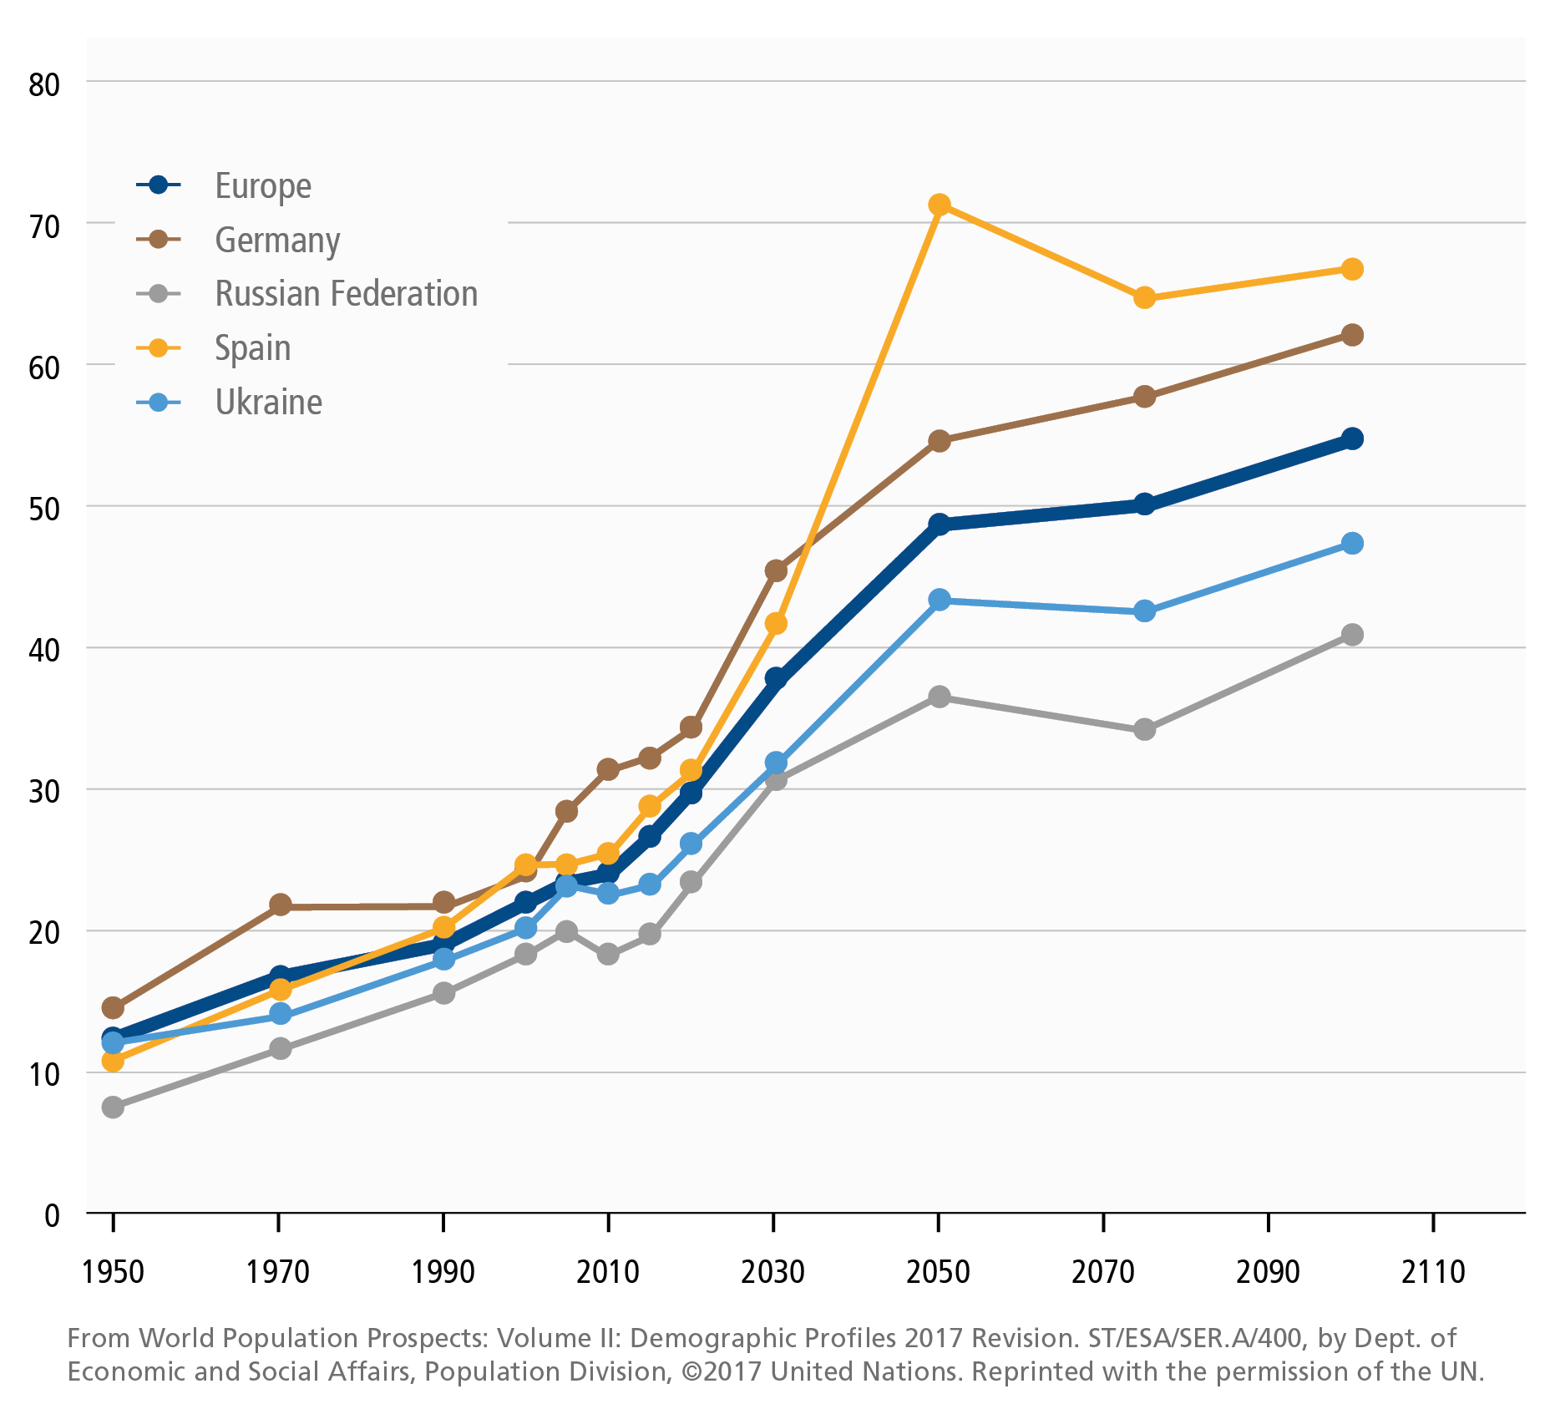
EPIDEMIOLOGY & BURDEN: EUROPE
Russian Federation: experienced 112,000 hip fractures in 2010, a figure expected to rise to 159,000 by 2035
By 2100, Russia is projected to reach a ratio of 40.7 seniors to 100 workers
Spain: By 2050, significantly older population compared to the European average
By 2100, estimates of 66.5 seniors to 100 workers
Dependency ratio of older adults
Dependency ratio: number of dependents per 100 people of working age

Slide 15
EPIDEMIOLOGY & BURDEN: EUROPE
EU6: fracture-related costs will increase from 37.5 billion euros 2017 to 47.4 billion euros by 2030
EU6: 65 – 80% of women do not receive treatment following a fracture
Broken Bones, Broken lives: EU6 2018 infographic

Slide 16
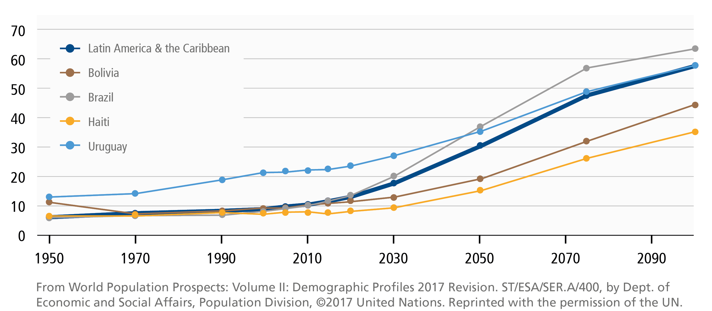
EPIDEMIOLOGY & BURDEN: LATIN AMERICA
Latin America: the second youngest world region in 2000 to the oldest world region by 2100
Latin America: The most rapidly ageing region of the world between 2015 and 2030.
A projected 71% increase in people 60 and over
By 2050, a projected 200 million people will be 60 years and over
Dependency ratio of older adults
Dependency ratio: number of dependents per 100 people of working age

Slide 17
EPIDEMIOLOGY & BURDEN: LATIN AMERICA
Brazil: hip fractures will more than double from 80,640 cases in 2015 to 198,000 cases by 2040
By 2050, a ratio of 36.7 seniors to 100 workers
Argentina: the 34,000 cases of hip fracture in 2009 is projected to increase to 76,000 cases by 2050
In 2009, hospitalization costs of hip and vertebral fractures exceeded US$190 million per year
Dependency ratio of older adults
Dependency ratio: number of dependents per 100 people of working age

Slide 18
EPIDEMIOLOGY & BURDEN: LATIN AMERICA
Mexico: more than 29,700 hip fractures occurred in 2005
By 2050, about 156,000-227,000 cases
Fracture cost 2010: US$256 mil.
Fracture cost 2020: US$364 mil.
Colombia: US$51 million was spent on hip fracture care in 2010
By 2035, there will be about 22,700 cases per year. Triple compared to 2010
Dependency ratio of older adults
Dependency ratio: number of dependents per 100 people of working age

Slide 19
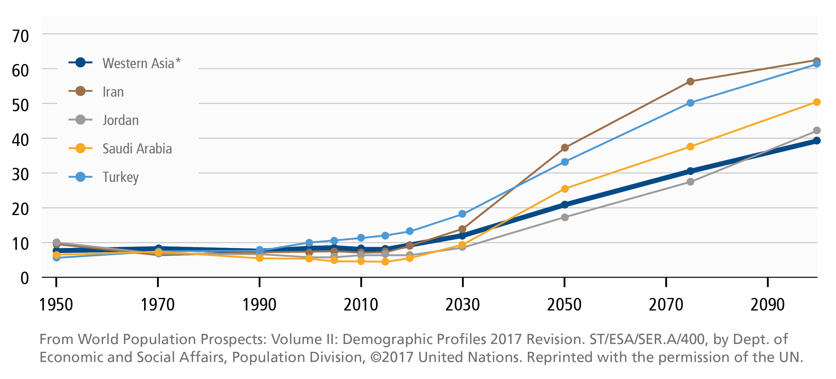
EPIDEMIOLOGY & BURDEN: MIDDLE EAST AND AFRICA
Middle East and Africa: 8-20% of the population is aged over 50 years
A 40% increase by 2050
Middle East: Rapid increase in ratios after 2030
Mortality rates post-hip fracture may be higher than western populations
Lebanon: 1-year mortality rate of 33% in 2004
Saudi Arabia: 2-year mortality rate of 27% in 2006
Turkey: 3-year mortality rate of 61% in females and 50% males in 2008
Dependency ratio of older adults
* The Middle-East and Africa region includes most of the UN-defined Western Asia region
Dependency ratio: number of dependents per 100 people of working age

Slide 20
EPIDEMIOLOGY & BURDEN: MIDDLE EAST AND AFRICA
Saudi Arabia: more than 7,500 cases of hip fracture in 2013
By 2025, estimates of more than 9,700 cases
Overall hip fracture cost: SR2.4 billion
Iran: Direct cost from hip fractures was US$28 million in 2010
By 2050, approx. US$250 million
Turkey: In 2009, 24,000 cases of hip fracture
Expected to increase to nearly 64,000 by 2035
Direct cost from hip fractures US$ 72 million in 2010 to US$205 million in 2050
Dependency ratio of older adults
* The Middle-East and Africa region includes most of the UN-defined Western Asia region
Dependency ratio: number of dependents per 100 people of working age

Slide 21
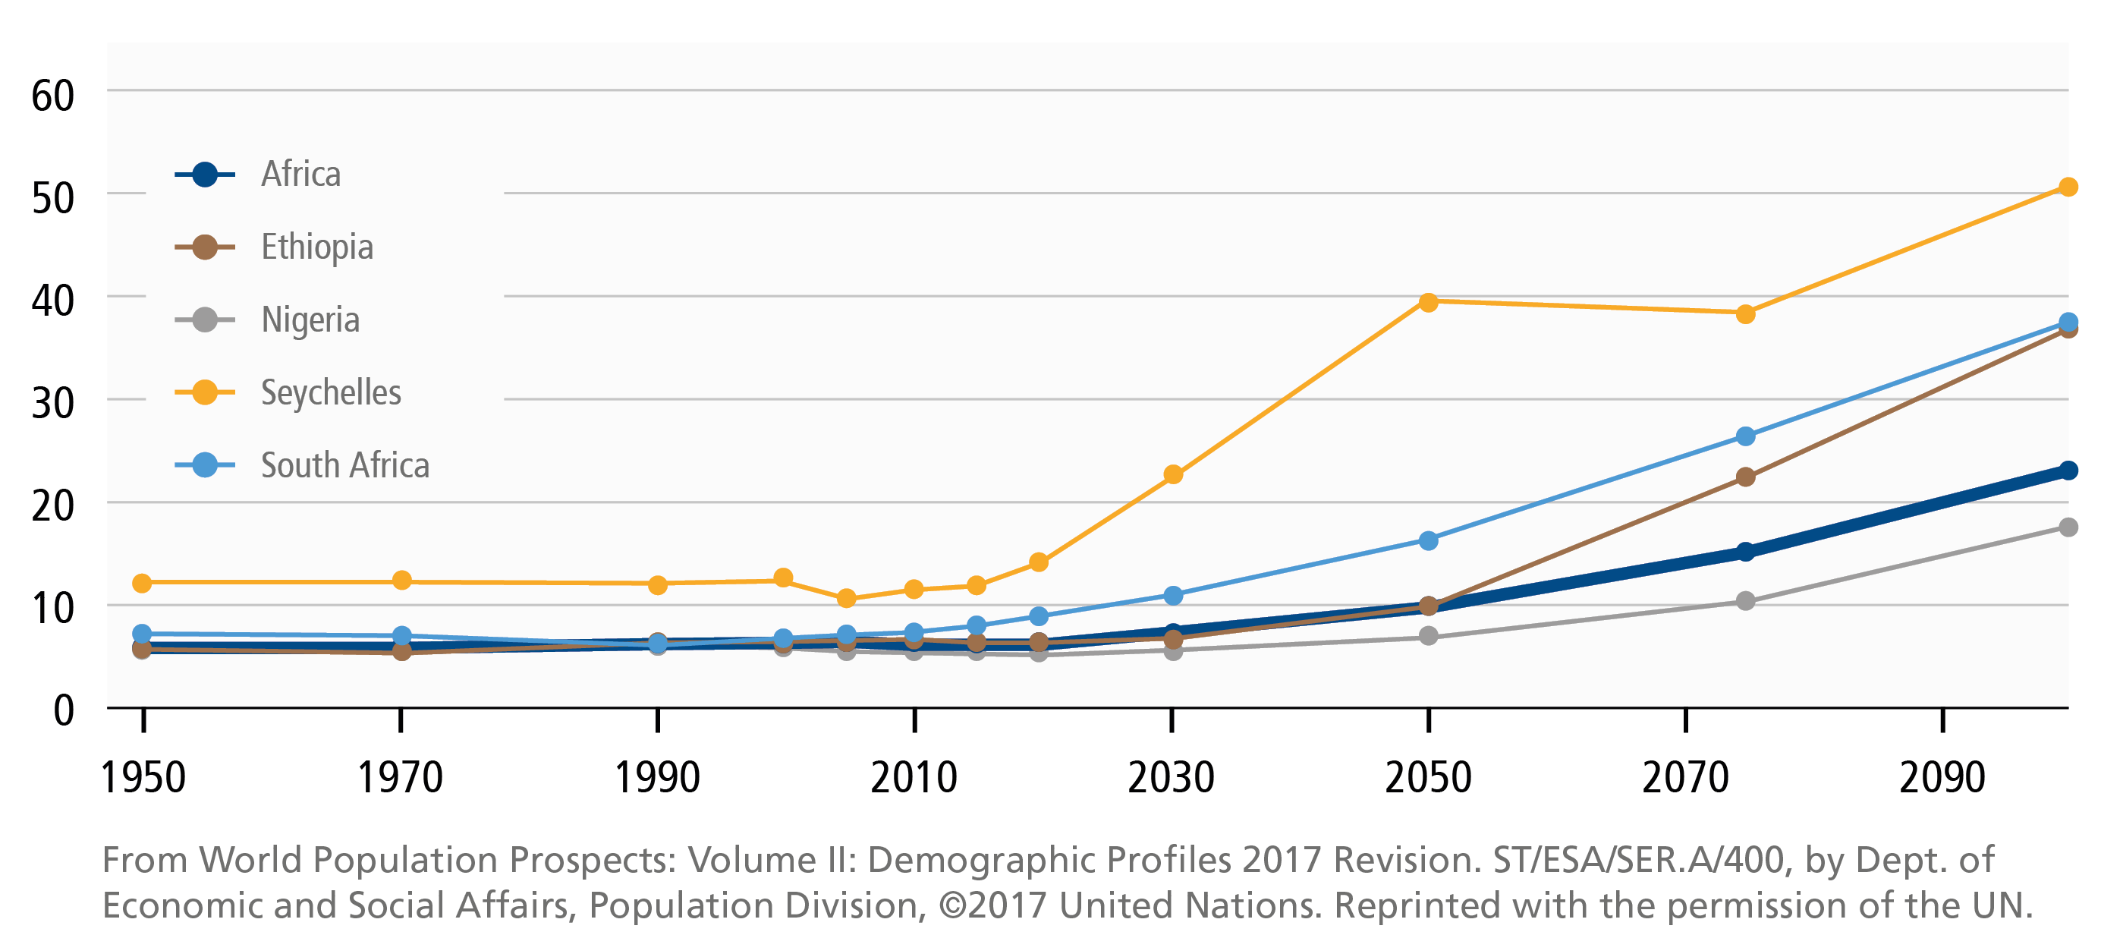
EPIDEMIOLOGY & BURDEN: AFRICA
Africa: World’s youngest region
With the exception of the Seychelles, Africa remains a young region for most of the 21st century
Dependency ratio of older adults
Dependency ratio: number of dependents per 100 people of working age

Slide 22
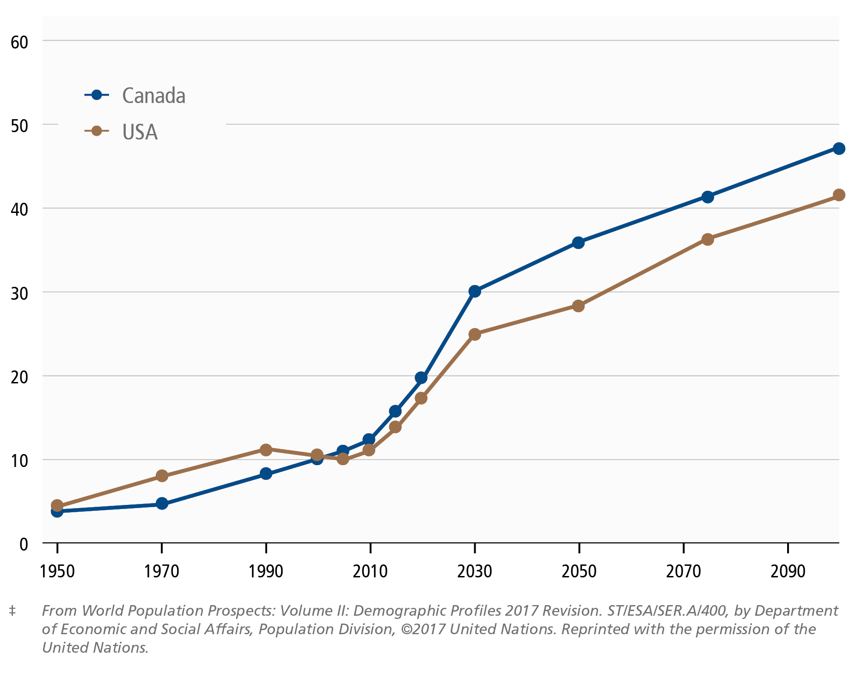
EPIDEMIOLOGY & BURDEN: NORTH AMERICA
North America: By 2025, the annual incidence of fragility fractures in the United States is projected to exceed 3 million cases, at a cost of US$25 billion
In 2015, the United Nations report stated that the population aged 60 years and over will increase by 41% by 2030
Dependency ratio of older adults
Dependency ratio: number of dependents per 100 people of working age

Slide 23
EPIDEMIOLOGY & BURDEN: NORTH AMERICA
Canada and USA: rapid increases in ratios between 2010 to 2030, followed by steady ongoing increases for the remainder of the century
Canada: 131,443 fractures between 2010-11 resulted in 64,884 acute care admissions and 983,074 acute hospital days
Total cost: CN$4.6 billion
USA: 258,000 hip fracture cases in 2010
289,000 projected cases by 2030
Dependency ratio of older adults
Dependency ratio: number of dependents per 100 people of working age

Slide 24
Osteoporosis can be treated
and fractures prevented
“There is a significant gap in osteoporosis care, and our hospitals are becoming revolving doors for fracture patients being sent home, and returning with new fractures, rather than being properly assessed and treated for osteoporosis”
Professor Peter Ebeling
Launch of Australian National SOS Fracture Alliance to “make the first break the last”

Slide 25
THE FRACTURE TSUNAMI CAN BE AVERTED
Clinically proven osteoporosis treatments have been shown to significantly reduce the risk of hip fractures, vertebral fractures and other clinically apparent fractures.
Prioritizing osteoporosis assessments and guidelines-based treatment for high fracture risk patients
Globally, current adherence with guidelines is poor, including treatment of individuals who have sustained fragility fractures.

Slide 26
A GLOBAL ISSUE
THE SECONDARY FRACTURE PREVENTION CARE GAP
International, national, regional and local studies report that most individuals who sustain fragility fractures do not receive guidelines-based care.
Asia
(67%)
Europe
(68%)
US & Canada
(79%)
2016 IOF World Osteoporosis Day Report. Harvey NCW, McCloskey EV et al.
Lem, W.F. and Raterman, H. G. 2017. Critical issues and current challenges in osteoporosis and fracture prevention. An overview of unmet needs.

Slide 27
Proven models of care exist which close treatment gaps
“Secondary prevention is the single most important, immediate mechanism to directly improve patient care and reduce spiraling fracture related healthcare costs.”
International Osteoporosis Foundation

Slide 28
FRACTURE LIAISON SERVICES
Closing the care gap for people who sustain fragility fractures (coordinator)
IDENTIFICATION FRACTURE Inpatient
IDENTIFICATION FRACTURE Outpatient
INVESTIGATION
Triage / Risk Assessment
Bone density
INITIATION
Pharmacological Lifestyle Falls Exercise Education
INTEGRATION - INFORMATION
Primary care Specialists

Slide 29
FRACTURE LIAISON SERVICES IMPROVE MANAGEMENT AND OUTCOMES
Fracture Liaison Services (FLS): a coordinated model of care for secondary fracture prevention. The FLS model increases:
Rate of bone health investigations for people who sustain fragility fractures
Osteoporosis treatment rates
Adherence with treatment
The FLS model of care is also associated with significant decreases in:
Re-fracture rates
Mortality

Slide 30
IOF CAPTURE THE FRACTURE® PROGRAM
WORLD OSTEOPOROSIS DAY THEMATIC REPORT
“Capture the Fracture” is a global campaign developed to facilitate the implementation of coordinator-based, post-fracture models of care for secondary fracture prevention.
Approx. 50% of people with one fracture will have another, with the risk doubling after a second fracture.
Lack of awareness means that patients never learn what caused their fracture, or receive treatment.
“IOF believes this is the single most important thing that can be done to directly improve patient care and reduce spiralling fracture related healthcare costs worldwide.” Professor Cyrus Cooper, IOF President
Capture the Fracture®:
A global campaign to break the fragility fracture cycle. IOF. www.capturethefracture.org

Slide 31
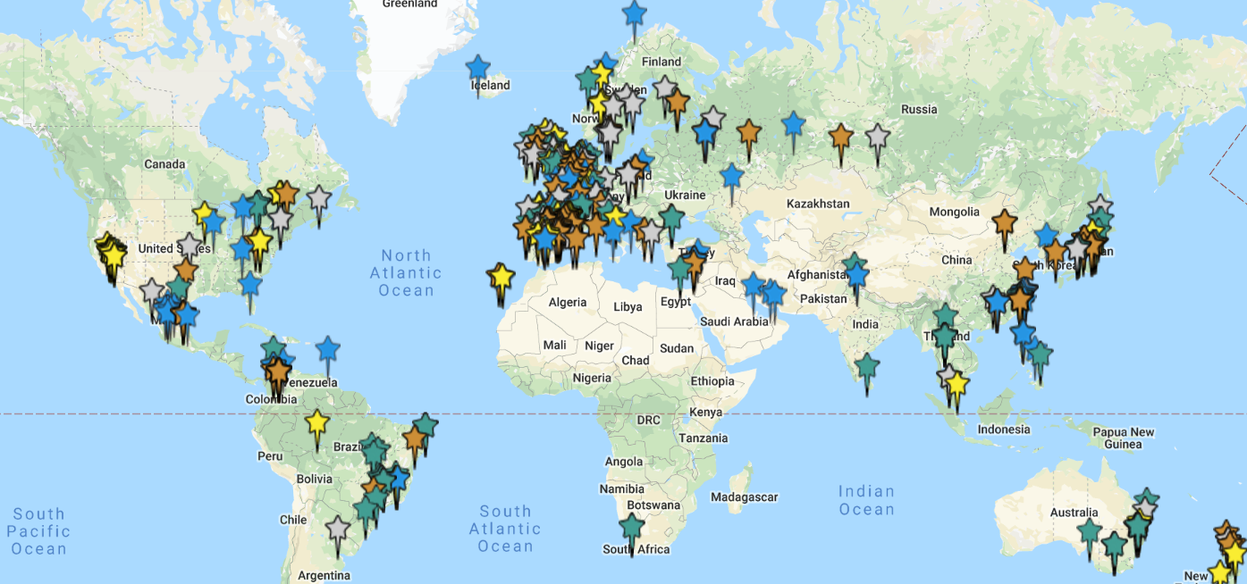
IOF Capture the Fracture® Map of Best Practice 380 Fracture Liaison Services from all world regions
International Osteoporosis Foundation. https://www.capturethefracture.org/map-of-best-practice-page

Slide 32
The IOF Compendium proposes 9 key priorities for the period 2020 - 2025

Slide 33
PRIORITIES 1 - 3
Priority 1: Secondary fracture prevention
Priority 2: Osteoporosis induced by medicines
Priority 3: Primary fracture prevention
Provide Orthogeriatric Services and Fracture Liaison Services to all elderly people who suffer fragility fractures
Osteoporosis management must become a standard consideration for clinicians when prescribing medicines with bone-wasting side effects
Increasing public awareness and education initiatives on the benefits of self-assessment with online fracture risk assessment tools such as FRAX®
For patients aged 50 years and over, primary care providers (PCPs) should routinely undertake fracture risk assessment

Slide 34
PRIORITY 4
Priority 4: Nutrition and Exercise
Expectant mothers: Advise government on optimising bone health of mothers and infants. Mothers must be well nourished to support an infant’s development in utero.
Children and adolescents: Educating the youth about peak bone mass, the necessities of a nutritious diet and regular physical activity.
Adults and Seniors: Inform adults on the nutritional and physical requirements for maintaining a healthy skeleton, avoiding premature bone loss and avoiding malnutrition in the elderly.

Slide 35
PRIORITIES 5 - 7
Priority 5: Healthcare professional education
Priority 6: Public awareness and education
Priority 7: Improving access and reimbursement for diagnosis and treatment
Engage Lead Clinicians in Osteoporosis, orthopaedic surgeons and primary care providers in professional education activities
Develop impactful public awareness campaigns which empower consumers to take ownership of their bone health
Osteoporosis must be designated a national health priority in all countries
In countries where the current disease burden is not known, epidemiological studies must be commissioned as a matter of urgency.

Slide 36
PRIORITIES 8 & 9
Priority 8: Development of national hip fracture registries
Priority 9: Formation of national falls and fracture prevention alliances
In countries without hip fracture registries, develop a business case for a registry and advocate to the government for resources to support widespread participation.
National alliance to improve outcomes for those who have sustained falls and fragility fractures
Formation of a national alliance has the potential to facilitate delivery of Priorities 1-8

Slide 37
In Conclusion
“Global efforts must be made to tackle the impending fragility fracture crisis. I urge all concerned stakeholders to make use of the IOF Compendium of Osteoporosis as a resource to help drive action for prevention in their countries” Cyrus Cooper, IOF President

